Slide 1

Department of Computer Science and Engineering Project Review 2
Team no: 09
Guide: Team Members:
Mr. Srinidhi Kulkarni Pallavi Singh[1jt15cs034]
Mr. Saravana MK Yashashwini R[1jt16cs061]

Slide 2
Paper 1
Image-based air quantity analysis using deep convolutional neural network
Methodology- This paper evaluates the air quality using images as an input. The technology used for this process is CNN Architecture.
This model achieved very high performance on ImageNet dataset, which has over 15 million high resolution images from 1000 categories.
Here 591×4=2364 images are used as a training set for the model to be build.
In this study, the performance of the proposed method using the evaluation which is defined as the number of correctly classified images divided by the number of all images.
Advantages -The collection of data and the analysis are made based on the pictures that was captured to find the PM2.5 concentration
Disadvantages- The images are mostly not in good quality.
Summary- The air quality concentration was attained by training images using deep learning algorithms using transfer learning

Slide 3
Paper 2
Data analysis using Box plot and Control Chart for Air Quality
Advantages- Handles Large Data Easily. The box plot does not keep the exact values and details of the distribution results, which is an issue with handling such large amounts of data in this graph type.
Disadvantages- Box Plot graph only work well when there is enough data to provide the statistic.
Methodology- This paper does a complete data analysis of air quality data.
The methodology used for data analysis is box plot.
A Box Plot, sometimes also known as whisker plot, is useful in identifying outliers and comparing distributions. Box Plot provides basic information about a distribution.
It graphically depicts a group of numerical data according to their quartiles.
Control chart: The control chart is a graph used to study how a process changes over time.
Data are plotted in time order. A control chart always has a central line for the average, an upper line for the upper control limit and a lower line for the lower control limit.

Slide 4
Paper 3
A Comparative analysis for Air Quality Estimation from Traffic and Meteorological Data
Methodology- . The approaches proposed for the aforementioned steps were evaluated with different dataset configurations, considering weather and traffic features at: (i) time t, (ii) from time t − 24 to time t, and (iii) from t − 48 to time t.
the selected models with different characteristics: (i) a linear regressor with Bayesian Ridge Regularization, (ii) a Neural Network Using Bayesian Regularization using decision trees as base estimators, and (iv) a Long-Short Term Memory (LSTM) model.
Advantages -The literature where time series of air pollutants are involved in the estimation for future forcastes, our approach provides results that are most on par with other works.
Disadvantages- Sensor and Satellite data maintenance.
Summary-The latter could allow a more fine-grained estimation on larger areas, without the need for detailed on-ground measurements.

Slide 5
Paper 4
Artificial Intelligence-Based Environment Quality Analysis System
Methodology-
The selected models with different characteristics: (i) a linear Regressor with Bayesian Ridge Regularization, (ii) a Neural Network Using Bayesian Regularization using decision trees as base estimators, and (iv) a Long-Short Term Memory (LSTM) model.
Advantages -The literature where time series of air pollutants are involved in the estimation for future forecasts, our approach provides results that are most on par with other works.
Disadvantages- Sensor and Satellite data maintenance.
Summary-The latter could allow a more fine-grained estimation on larger areas, without the need for detailed on-ground measurements.

Slide 6
Paper 5
Time series air quality data based on exploratory data analysis and representation
Methodology-
Three aspects of environment air quality are analyzed,
detect the trends in data. The change tendency of environment air quality is analyzed based on some visual methods.
discover the potential time changes and changing patterns existed in the time series data. Through temporal analysis we try to further exploring the data distribution in different time periods.
related analysis. Combining the correspondence weather data the related factors which should affect the environment air quality are analyzed.
Advantages -The history data has undergone complete descriptive analysis for knowing the previous status.
Disadvantages- Only the tendency and hidden patterns in the data.
Summary-The air quality analysis has run through the data to know the complete status of air pollutants in each place that was captured and stored in the data.

Slide 7
Problem statement
Air pollution in cities has become a cause for fear and has been a major topic of concern. All forms of life including plants and animals depend on air for their basic survival.
Currently, air quality monitoring methods are mainly based on monitoring stations, which are not available to the majority of regions because of the high setup cost and expensive sophisticated sensors.
Even after setting up the station, the data that gets collected be enamors and is very difficult to maintain, analyze and act upon it.

Slide 8
Literature Survey
Air Quality Prediction using Machine Learning
This paper is aimed to predict the Air Quality Index (AQI) by the use of advanced Machine learning algorithms.
This paper addresses the challenge of predicting the Air Quality Index (AQI), with the goal to reduce the pollution before it gets unfavorable.
Regression analysis on the dataset, and prediction results shows which meteorological factors impact the AQI values most.

Slide 9
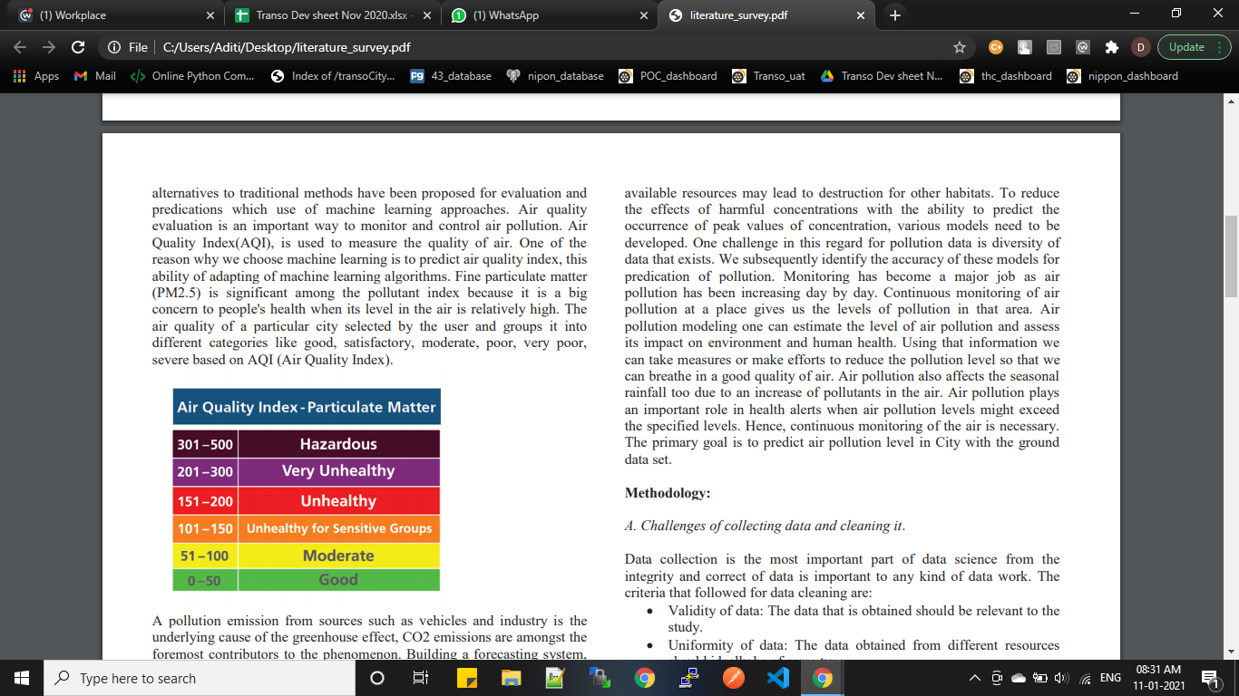
Literature Survey
Study of air quality index:
The key parameters have been selected which can affect the Air quality index are temperature, humidity, pressure, wind speed, PM10 and SO2 respectively.
The resultant of air quality of a particular city is grouped into different categories like good, satisfactory, moderate, poor, very poor, severe based on AQI (Air Quality Index)set by international standards .

Slide 10
Existing and Proposed System
Existing system are IOT based monitoring system where in the data collected are from the sensors that are set up with high cost which is made difficult to monitor and analyze the data.
Proposed system is a Machine Learning approach to reduce the cost of the setup and increase the analysis of the data that resultants to better prediction which in-turn is made best to take actions.

Slide 11
Methodology
Steps to be solved:
Collecting appropriate data from multiple resources, integrating it together and cleaning it.
Data analysis process.
Machine learning algorithms for air quality index prediction

Slide 12
Machine learning algorithms for air quality index prediction
Linear regression:
Linear Regression is an algorithm based on the machine learning that depends on supervised learning which performs a regression task.
Depending on the connection among the established and the independent variables, different regression models differ.
As a resultant, the best line is fit that tells future outcome.

Slide 13
Machine learning algorithms for air quality index prediction
Random Forest Regressor:
Random forest consists of a large number of individual decision trees that operate as an ensemble.
Each individual tree in the random forest spits out a class prediction and the class with the most votes becomes model’s prediction.
As a resultant, the best line is fit that tells future outcome.

Slide 14
Machine learning algorithms for air quality index prediction
Lasso Regression:
Least Absolute Selection Shrinkage Operator wherein shrinkage is defined as a constraint on parameters
The goal of lasso regression is to urge the subset of predictors that minimize prediction error for a quantitative response variable.
Lasso multivariate analysis helps analysts to work out which of the predictors are most vital.

Slide 15
Thank you

